Slide 1
Molecular Methods in phytoplankton research/monitoring: Case studies from the Gulf of Trieste
Dr. Timotej Turk Dermastia, Marine Biology Station Piran, National Institute of Biology

Slide 2
CASE STUDY: Metabarcoding diatom communities
Yearly comparison of markers (18S and rbcL) and methods (metabarcoding and microscopy) – Which to choose, benefits and drawbacks
Population structure
HAB identification

Slide 3
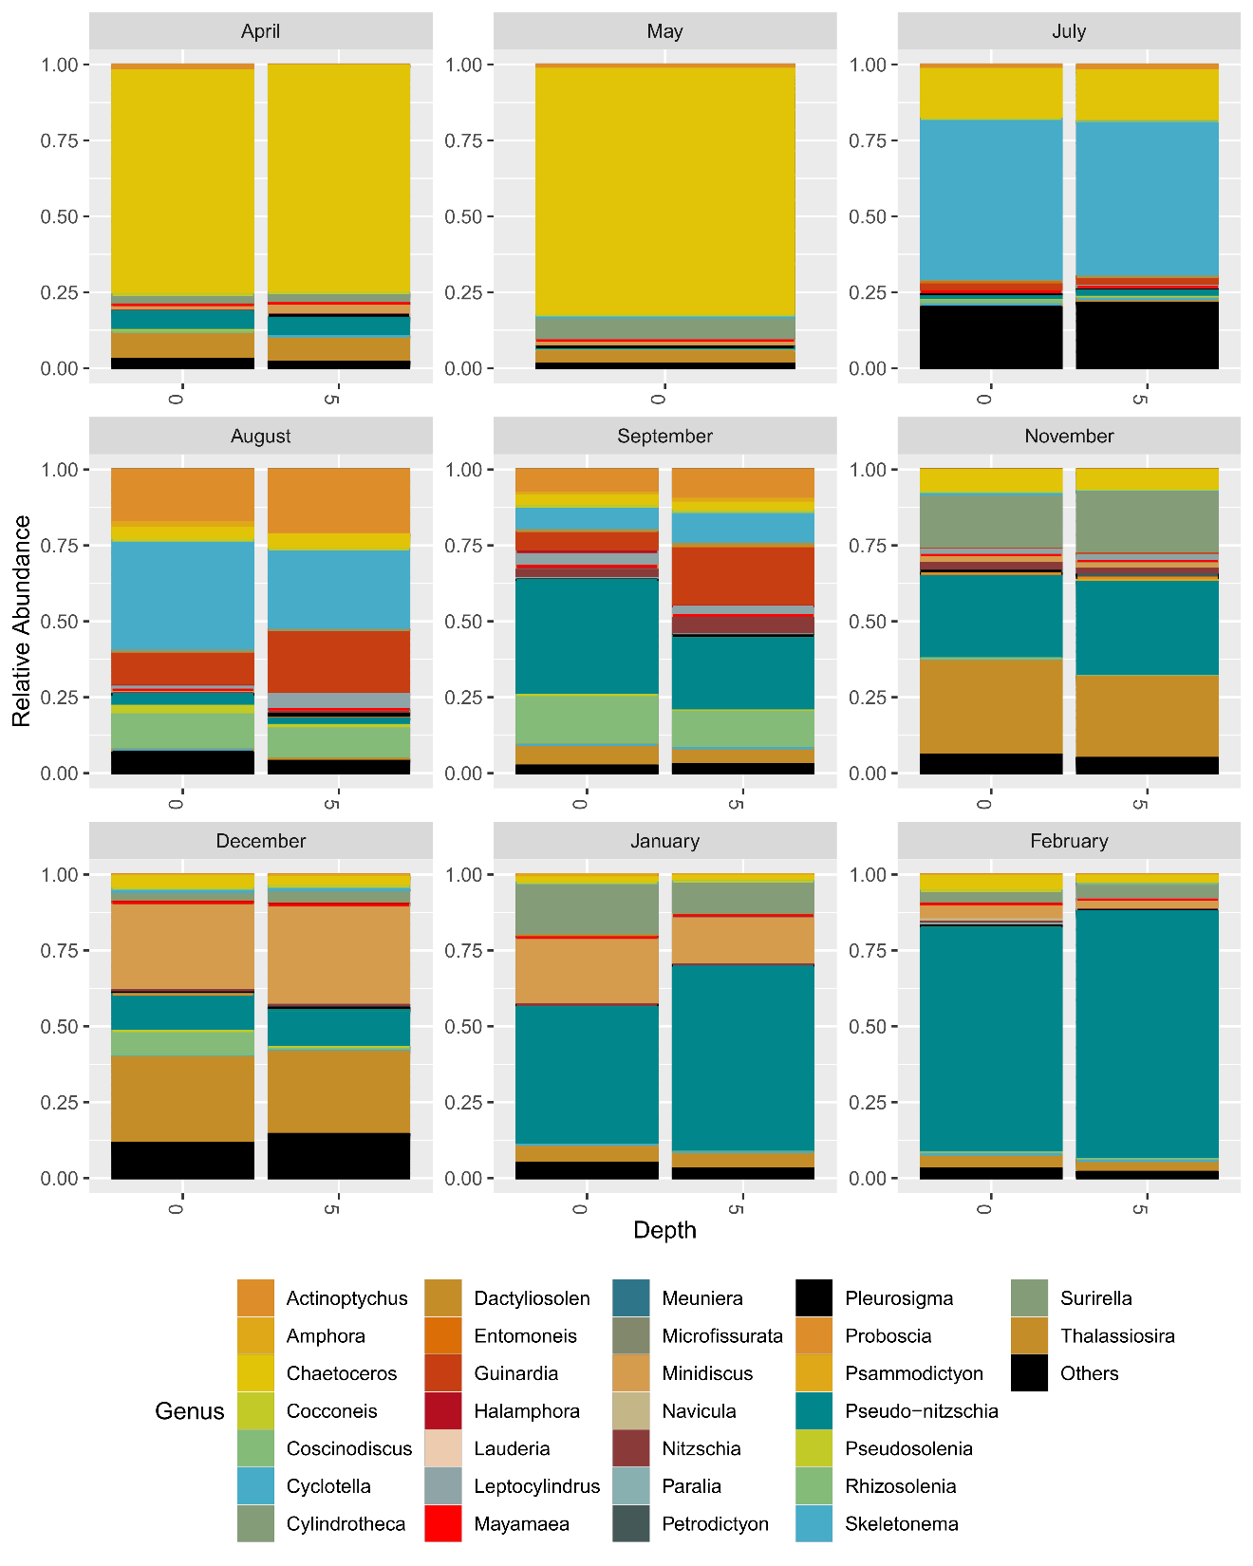
18S-V9 (150bp barcode)
rbcL (150bp barcode)

Slide 4
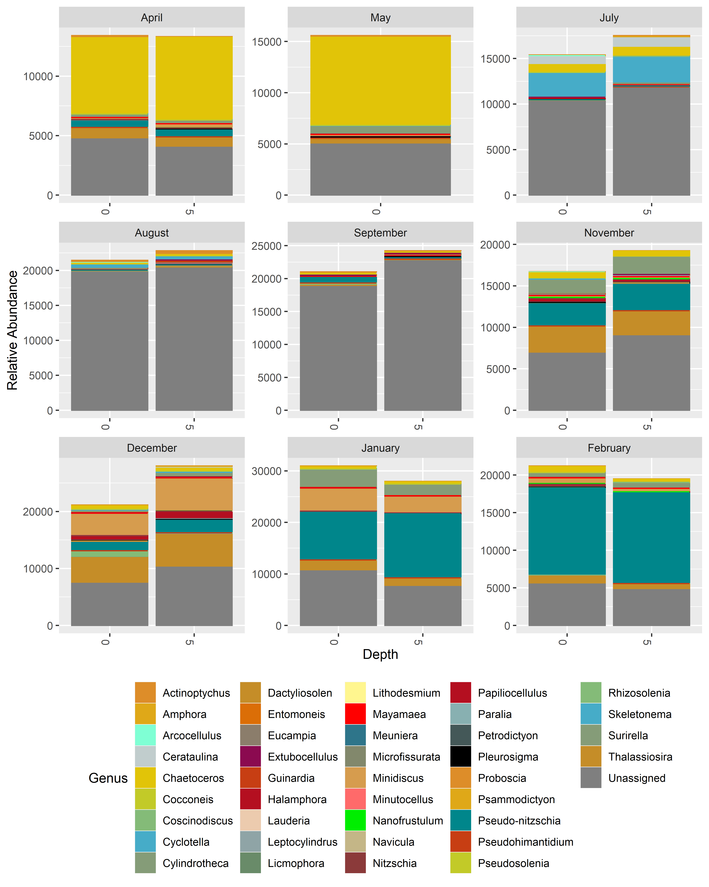
Unassigned reads
18S-V9 (150bp barcode)
rbcL (150bp barcode)

Slide 5
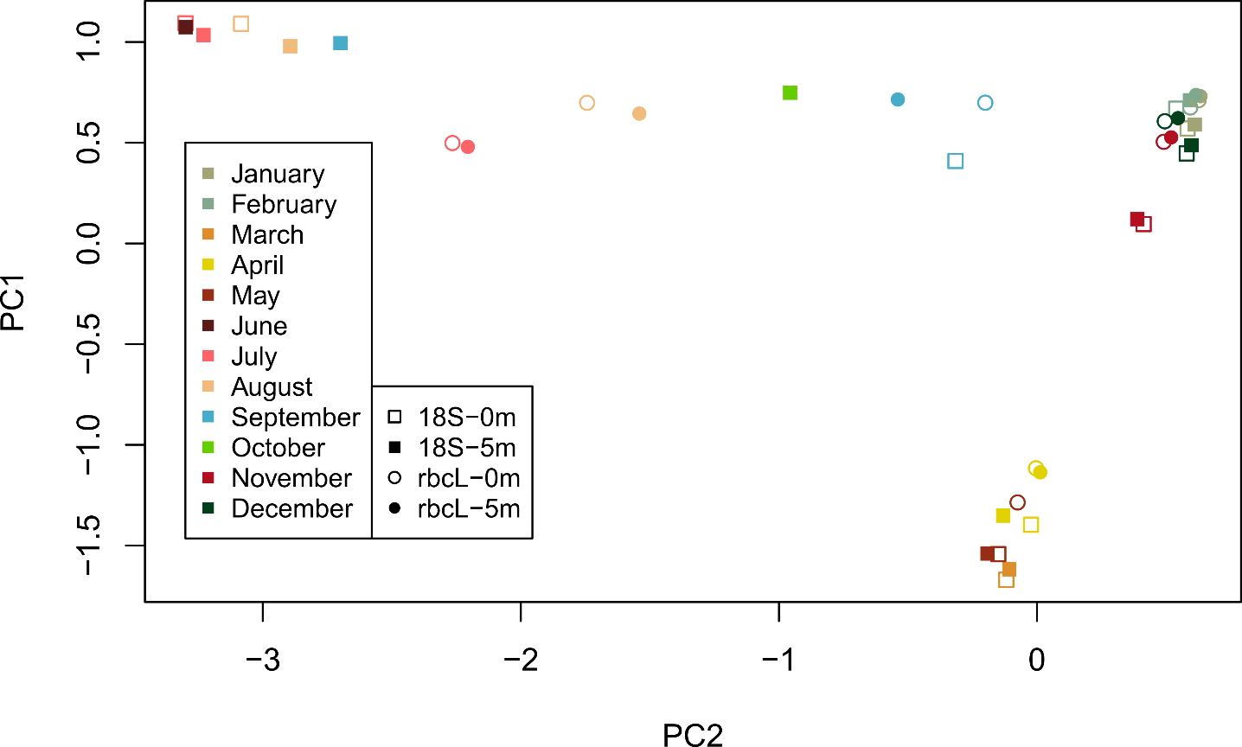
WINTER
SPRING

Slide 6
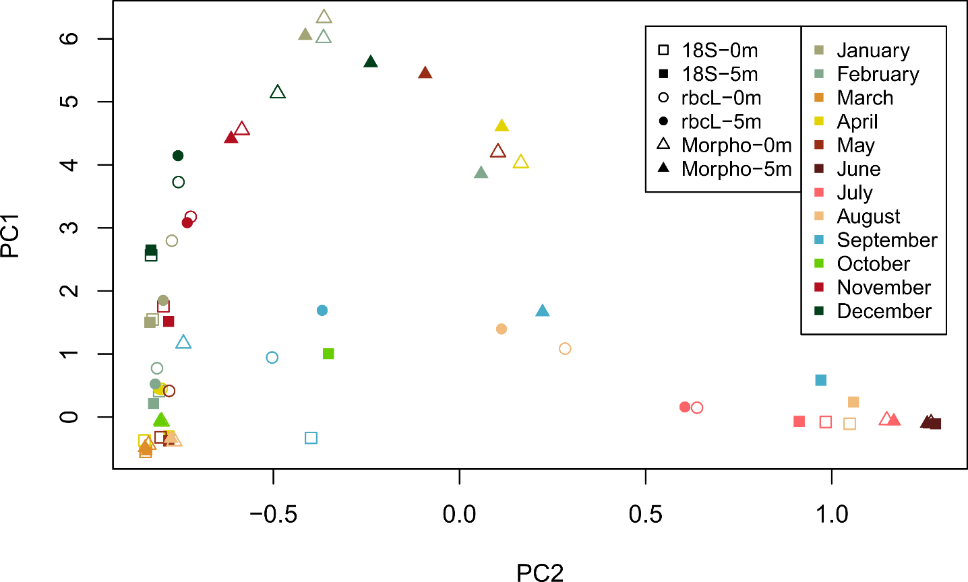
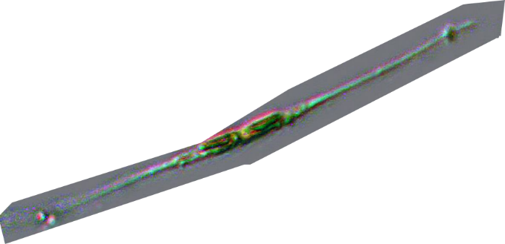
MICROSCOPY

Slide 7
MICROSCOPY
New genera: Minidiscus, Thalassiosira

Slide 8
Discrepancies – reasons and explanations
Cell number ≠ sequence read number. Relationship is also taxon specific.
Some inconspicuous taxa cannot be resolved with light microscopy, leading to misclassification or no classification.
Lack of reference sequences can be problematic for molecular methods
Resolution of molecular methods far greater. This is just on the level of genus!

Slide 9
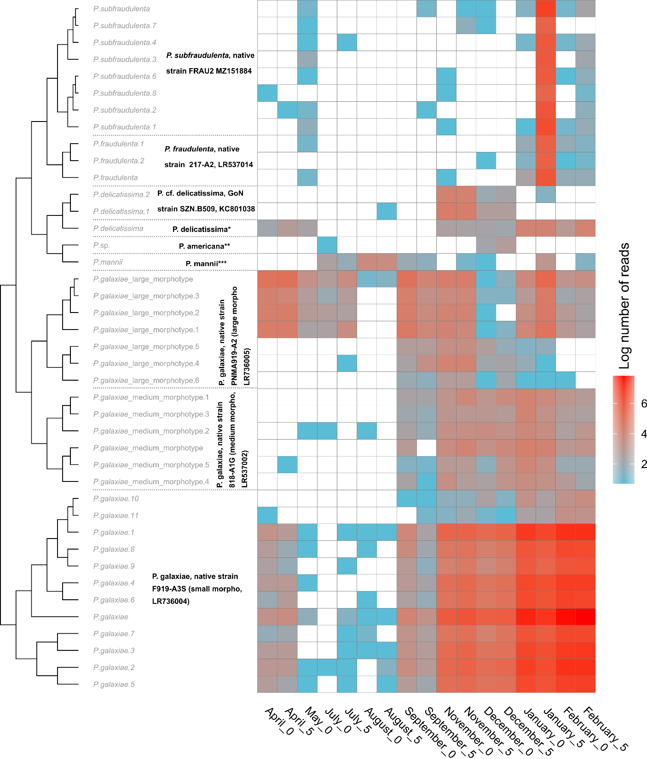
Pseudo-nitzschia (HAB genus) seasonal succession

Slide 10
rbcL obtained population structure of Pseudo-nitzschia galaxiae and Chaetoceros tenuissimus

Slide 11
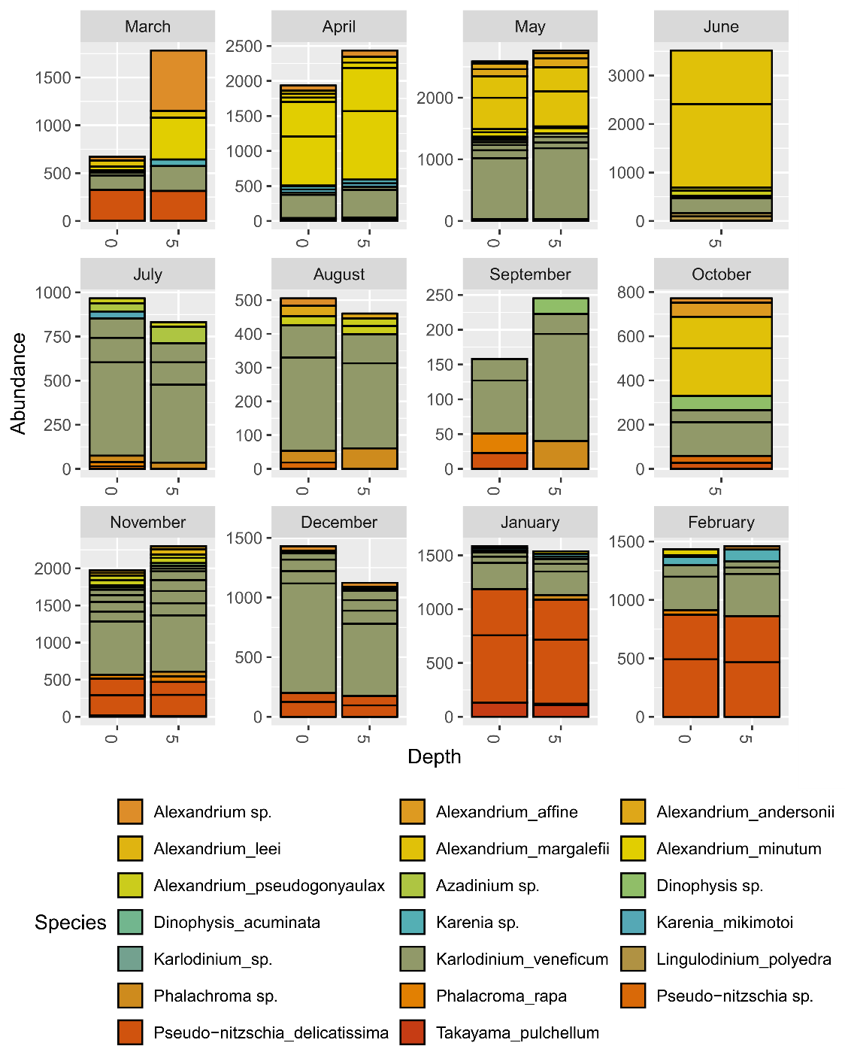
HAB taxa dynamics with 18S

Slide 12
CASE STUDY: Plankton communities in the Gulf of Trieste – Joint action between NIB and OGS
Expected outcome:
A spatially and temporarily broad analysis of different levels of the plankton community. Bacterioplankton and phytoplankton will be analyzed with standard phylogenetic markers (16S and 18S), while zooplankton will be analyzed with COI.
Potential to uncover unknown diversity, invasive species and harmful organism and understand the ecological roles and impacts of certain species on the entire planktonic community.
Scientific paper(s)

Slide 13
Aim: To test consolidated protocols on three different trophic levels
Progress summary:
Year-long monthly sampling for bacterioplankton, phytoplankton and zooplankton in the Gulf of Trieste
Two LTER stations (C1 in Italy and Vida in Slovenia)
Sampling and sequencing concluded. Bioinformatic analysis ongoing.

Slide 14
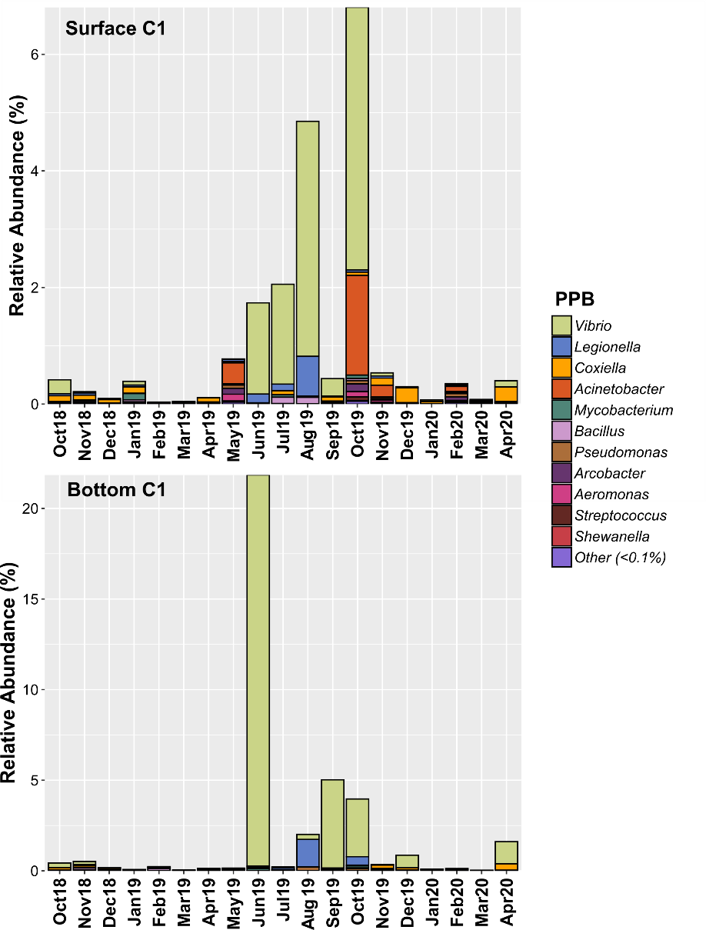
Example of data rendering for environmental threat assessment: potential bacterial pathogens:
Courtesy of Mauro Celussi, OGS

Slide 15
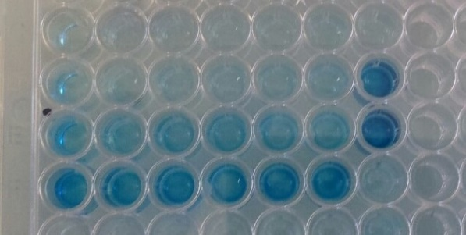
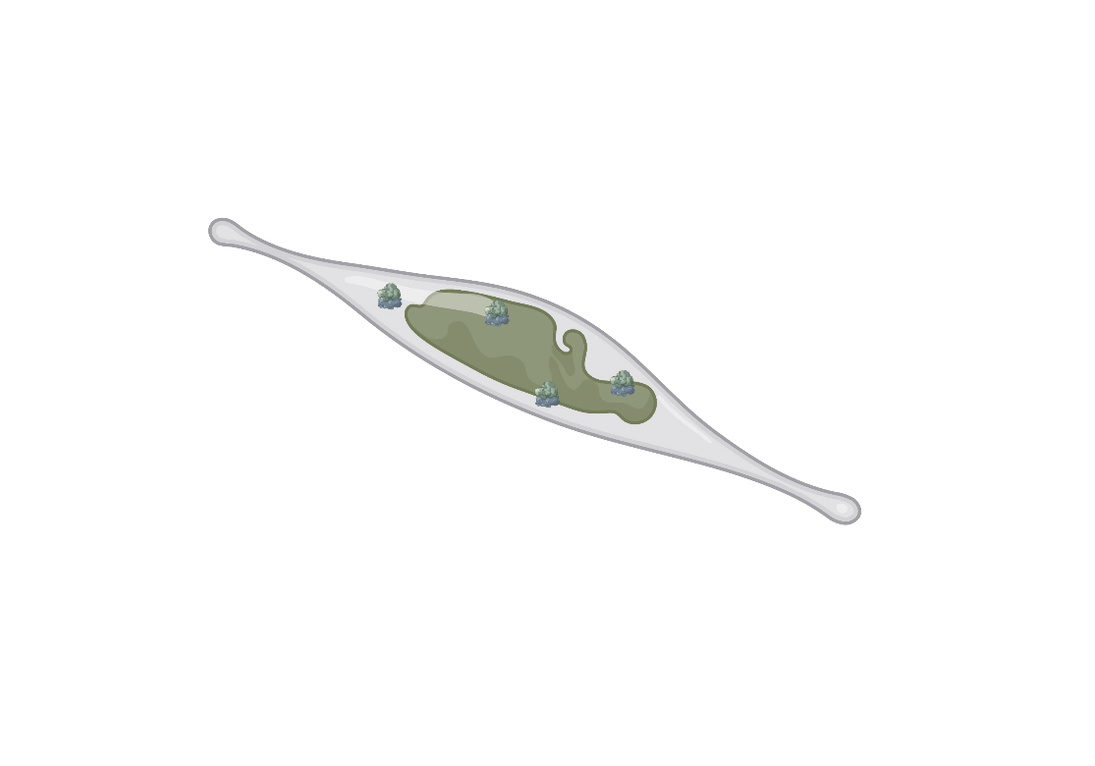
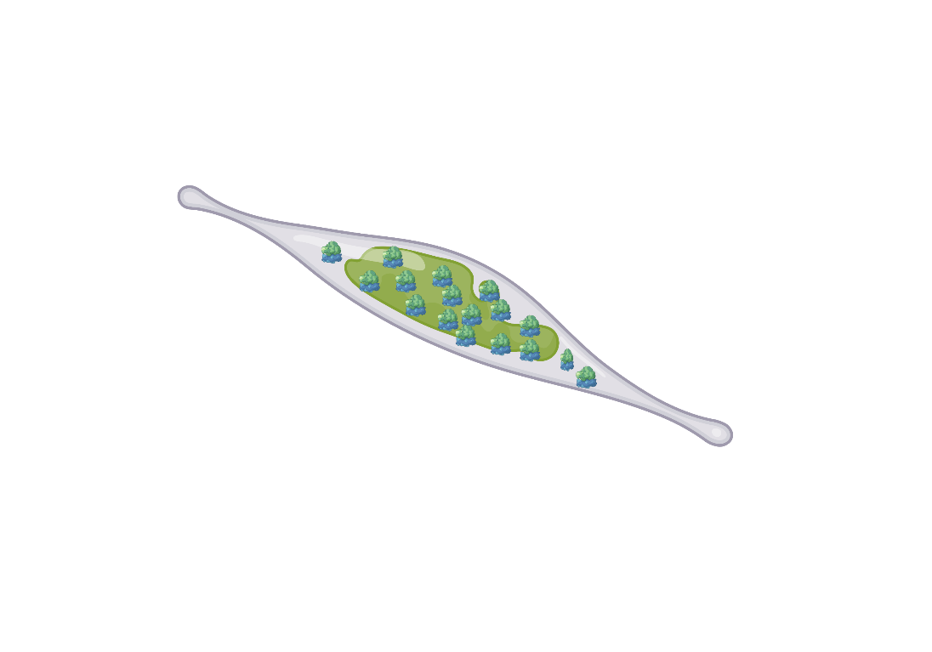
CASE STUDY: Hybridization assays for HAB monitoring
The soluion:
Ribosome with rRNA
Detection/Quantification (colorimetry)
Resting cell:
Active cell:
Senescing cells:
Signal
RNA concentration

Slide 16
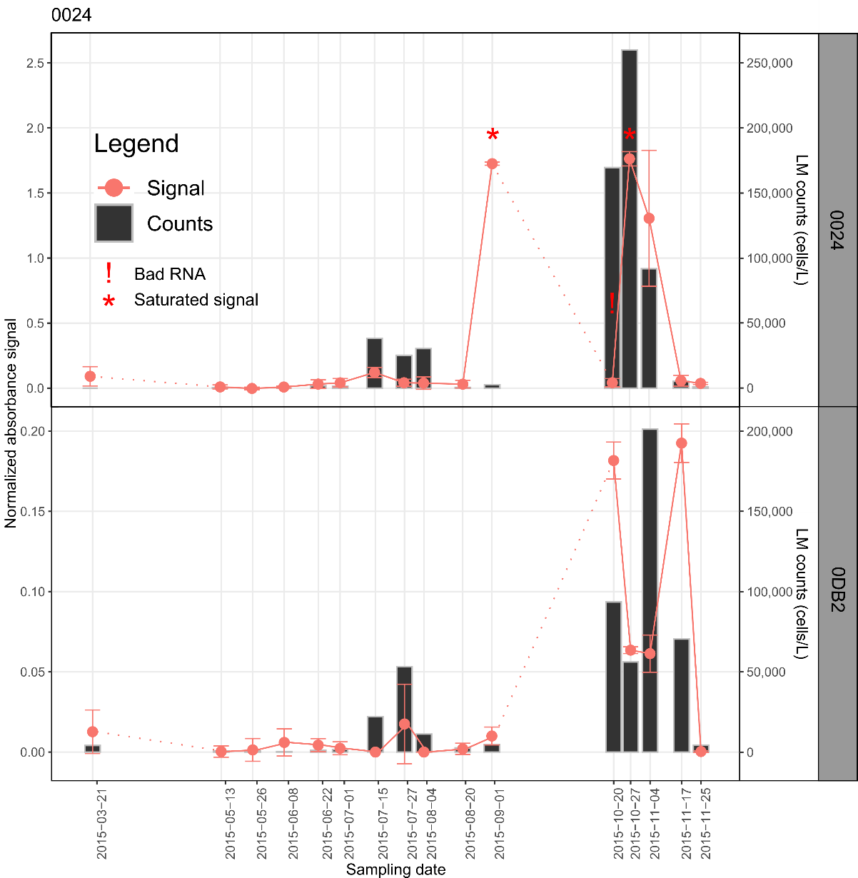
CASE STUDY: Hybridization assays for HAB monitoring
Time-series of assays compared to microscopic counts.
Signal generally in accordance with counts, except in certain cases i.e. 0024, 1 September 2015 – Bloom anticipation?

Slide 17
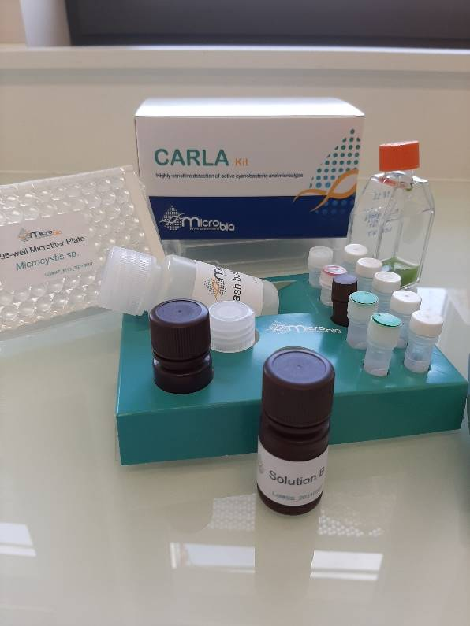
CARLA kit
Probes are publicly available but require calibration and validation by individual laboratories.
Ready-to-use kits are available for purchase from Microbia Environement
Assay patented and marketed as CARLA (Cellular Activity RNA-based eLisA) kit by Microbia Environement, used for cyanobacteria, Dinophysis, Alexandrium and Pseudo-nitzschia

Slide 18
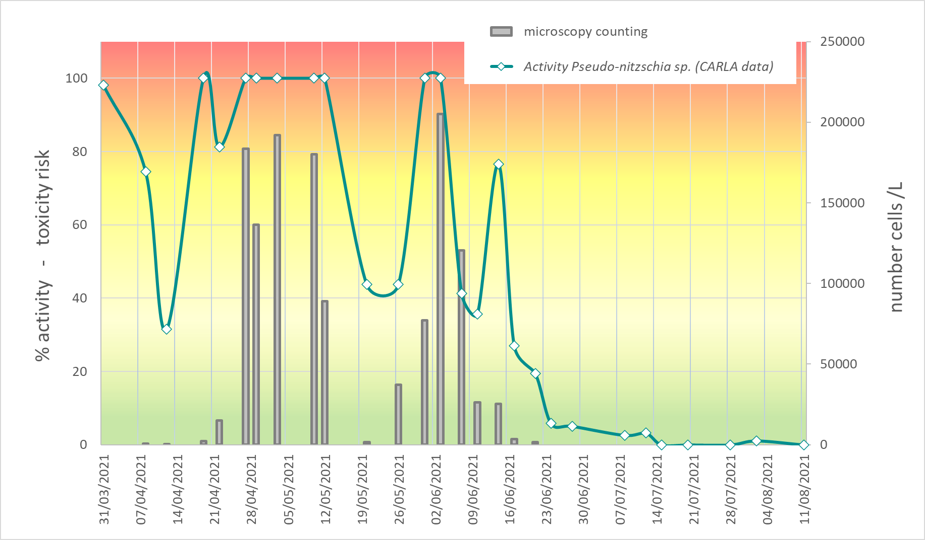
CARLA kit
Courtesy of Microbia Environement

